Slide 1
Hydrothermal Vents and the Savanna
Jasmen Cheese
Melissa Liu
Alex Morales

Slide 2
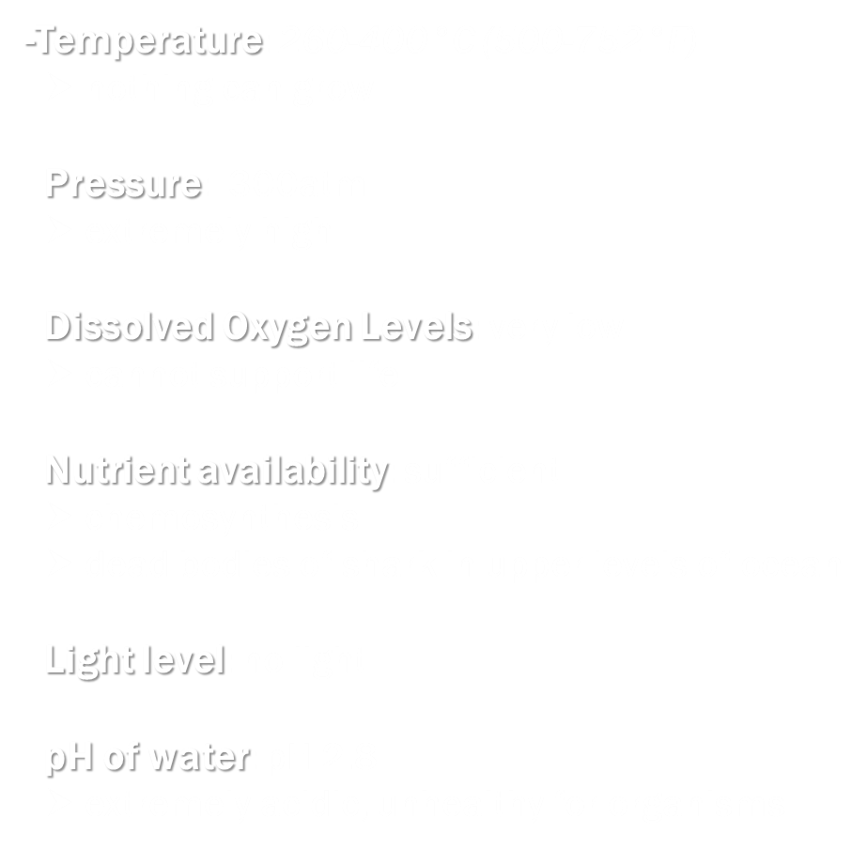
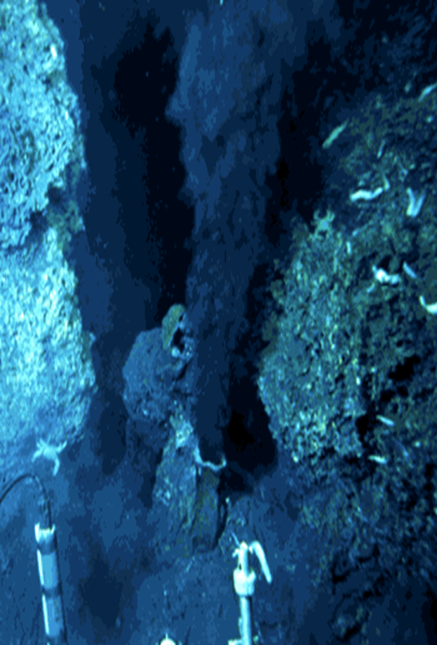
Hydrothermal Vents: Abiotic Factors
Temperature: 260-400°C (500-752°F)
nothing can grow
Pressure: 300atm
extremely high
Dissolved Oxygen Levels: very low
cannot support life
Nutrient availability: sufficient
chemosynthesis
dead bodies of shark in upper levels of ocean
Light level: no light
pH of water: pH 2.8
extremely acidic, unhealthy for organisms

Slide 3
Hydrothermal Vents: Biotic Factors
Chemosynthesis
Chemicals to produce energy
Symbiosis
Organism working together
Both Benefit
400 Different Kinds of Animals

Slide 4
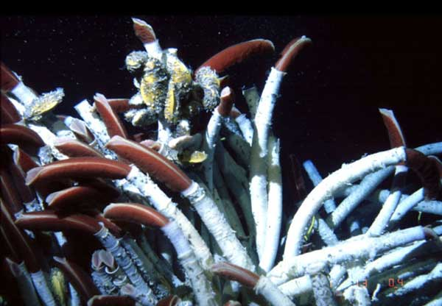
Hydrothermal Vents: Adaptations
Producers
  Chemosynthesis
  Symbiosis
  Carotenoids
Predators
  Red- hemoglobin
  Eyes that don’t see
  Colonization

Slide 5
The Savanna: Abiotic Factors
Temperature: 68° to 86°F
little variation
Precipitation levels: 10-30 inches of rain annually
great variation throughout the year
most rainfall in wet season
Seasonality: the dry and wet season
Dry: May to October
Wet: December to March
Soil conditions: porous, rapid drainage of water
conditions vary with location
Elevation: near sea level to above 6000 ft.
Humidity: low humidity for dry season
high humidity for wet season

Slide 6
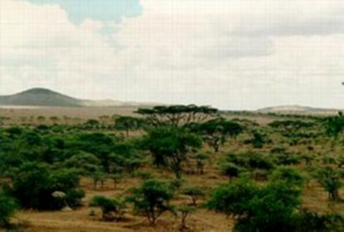
The Savanna: Biotic Factors
Vegetation (tall grasses, shrubs, and trees)
Large grazing herbivores, large carnivorous cats , and other meat eating creatures.
mutual & parasitic relationship
Rhinoceros, Egrets, and ticks

Slide 7
Adaptations in Savannas
Producers
  Baobobs’ water storing trunk
  Poisonous candelabra trees
  Jackal Berry Trees and termites
Predators
  Giraffes’ long necks
  Elephants’ strong trunks
  Cheetahs’ non-retractable claws

