Slide 1
Invertebrates:
Platyhelminthes & Nematoda
Barbara Leary and Amy Vallis
AP Biology
8 April 2011

Slide 2
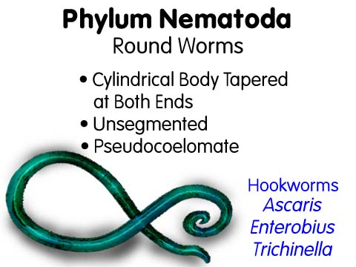
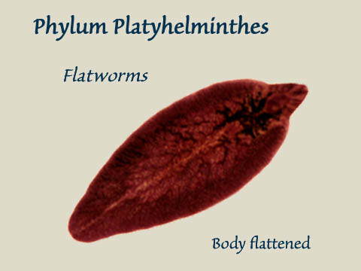
Platyhelminthes and Nematoda
BOTH exhibit bilateral symmetry
(right and left side of body are mirror images of one another)

Slide 3
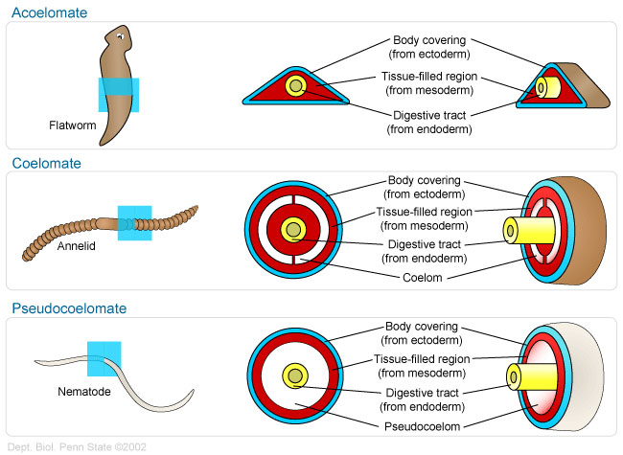
TISSUE LAYERS
NEMATODA are tribloblastic pseudocoelomates with no muscle layers surrounding the digestive track .
PLATYHELMINTHES are triploblastic acoelomates lacking body cavity between the digestive track and the body covering with a tissue filled region, but no true coelom.
ACOELOMATE!!!!!

Slide 4
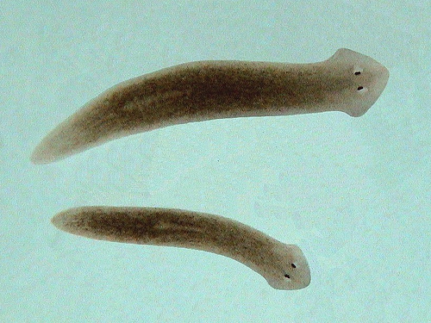
CEPHALIZATION
Both Platyhelminthese and Nemotoda display cephalization.
Platyhelminthes display more obvious cephalization that nemotoda.
PLANARIAN(platyhelminthes)

Slide 5
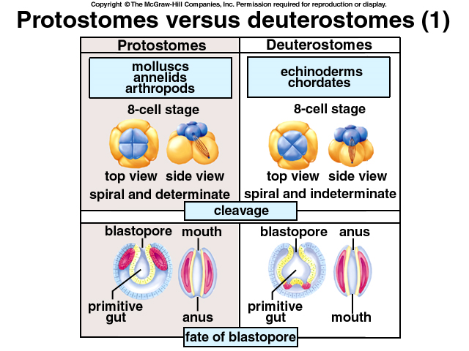
EMBRYONIC DEVELOPMENT
-Nematoda and Platyhelminthes are BOTH protosomes since they embyo forms a blastopore and becomes the archenteron which eventually spurs gut growth.

Slide 6
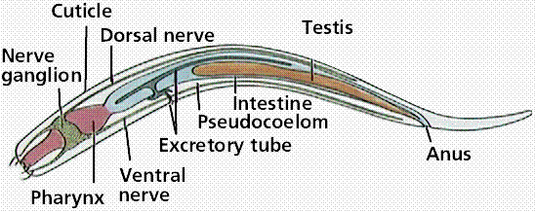
DIGESTIVE SYSTEM
The oral cavity opens into a muscular sucking pharynx. Digestive glands are found in this region of the gut, producing enzymes that start to break down the food.
There is no stomach, with the pharynx connecting directly to the intestine that forms the main length of the gut. This produces further enzymes, and also absorbs nutrients through its lining,
The last portion of the intestine is lined by cuticle, forming a rectum which expels waste through the anus just below and in front of the tip of the tail.
Notes:
The intestine also has valves or sphincters at either end to help control the movement of food through the body.

Slide 7
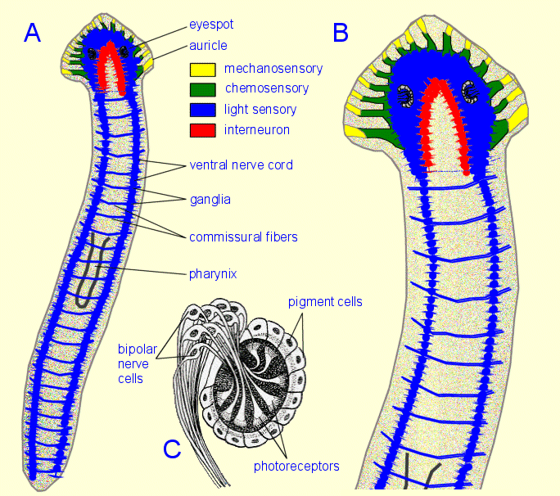
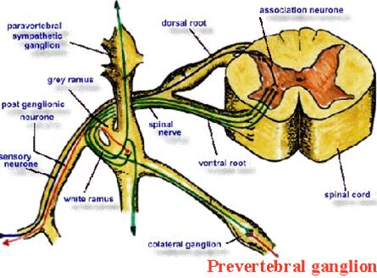
NERVOUS SYSTEM
Platyhelminthes
Nematoda
-Elaborate nervous system to easily respond to stimuli
-Composed of a circum-pharyngeal nerve ring that is made up of four nerve ganglia from which six longitudinal nerves extend down longitudinally through the body to the various parts of the gut and the reproductive organs.
-Six shorter nerves extend forwards from the circum-pharyngeal ganglia towards the mouth.
- With an elaborate nervous system, they can adapt to various environments.
-Consists of a pair of anterior ganglia or a nerve ring connected to 1 - 3 pairs of longitudinal nerve chords with transverse joining
-In platyhelminthes, the beginning of cephalization can be seen with the concentration of nerve cells in the anterior part of the body

Slide 8
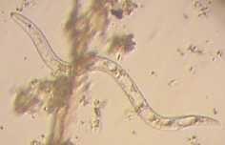
EXCRETORY SYSTEM
Nitrogenous waste is excreted in the form of ammonia through the body wall, and is not associated with any specific organs. However, the structures for excreting salt to maintain osmoregulation (process that keeps the organism's fluids from becoming too diluted or too concentrated) are typically more complex.

Slide 9
CIRCULATORY SYSTEM
NONEXISTENT

Slide 10
Works cited
http://web1.d25.k12.id.us/home/staff/rudeer/phylum_nematoda1.jpg
http://web1.d25.k12.id.us/home/staff/rudeer/phylum_platyhelminthes.jpg
http://www.esu.edu/~milewski/intro_biol_two/lab__10_platy_nemat/Nematoda.html
https://wikispaces.psu.edu/download/attachments/38807300/Fig6.jpg
http://www.mhhe.com/biosci/genbio/maderbiology7/graphics/mader07b/online_vrl/images/0594al.jpg
http://cas.bellarmine.edu/tietjen/images/platyhelminthes.htm
http://www.biology-questions-and-answers.com/nematoda.html
http://www.pharmainfo.net/files/images/stories/article_images/Sympathetic%20and%20parasympathetic%20neurons%20with%20ganglion.JPG
http://www.biology-questions-and-answers.com/flatworms.html

