Slide 1
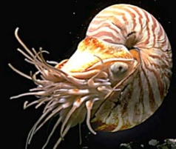
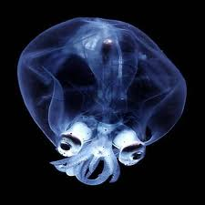
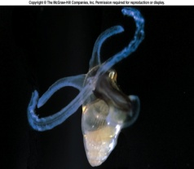
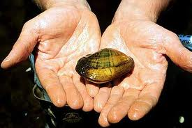
Mollusca

Slide 2
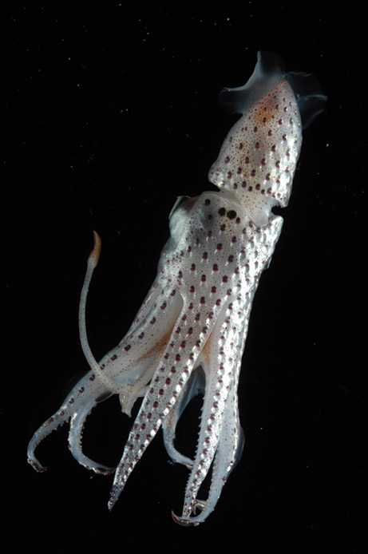
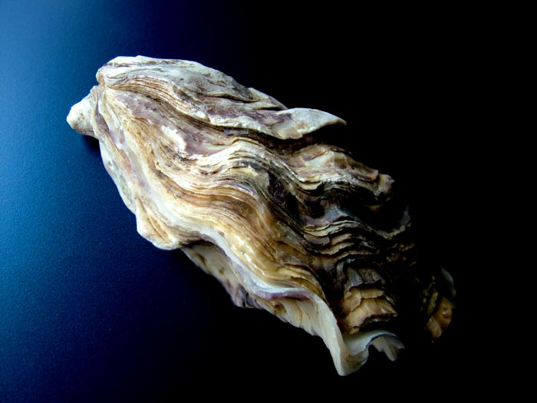
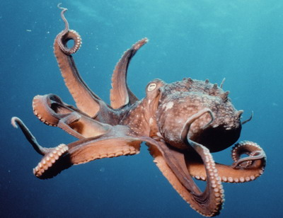
General Structure
Bilaterally Symmetric
Coelomates
  Presence of a body cavity
Endothermic
Triboblastic
  Endodermic, ectodermic, and mesodermic tissues
Cephalization is evident
  Neurons concentrate in a ganglial pattern.

Slide 3
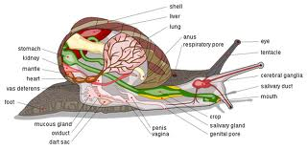
General Diagram

Slide 4
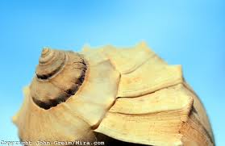
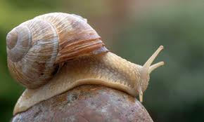
Body Systems
Digestive System
  Special radula - a belt-like chitonous sheath bearing recurved teeth
  Stomach, digestive gland branches to digestive tract
Nervous System
  Chemosensory organs (gastropods, bivalves), image-forming eyes (cephalopods)
Circulatory & Excretory System
  Heart, arterial & venous system
  Gills well developed, except for pulmonate snails which have a specialized vascular "lung" (a highly modified mantle cavity)
  Functional anus

Slide 5
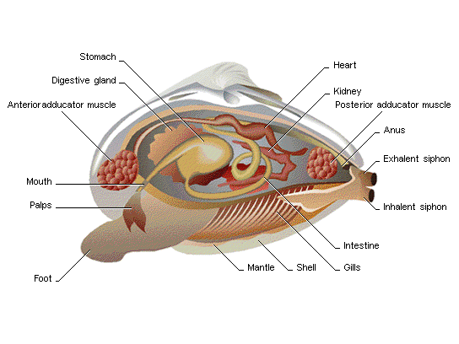
Digestive System

Slide 6
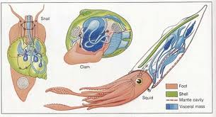
Nervous System

Slide 7
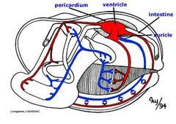
Circulatory System

Slide 8
Development & Life Cycle
Protostomes
The trochophore larval stage is followed by a free-swimming veliger larva in most species.

Slide 9

Mollusks
Snails
Slugs
Octopus
Cuttlefish
Chitons
Tusk shells
Oysters
Squids.

