Slide 1
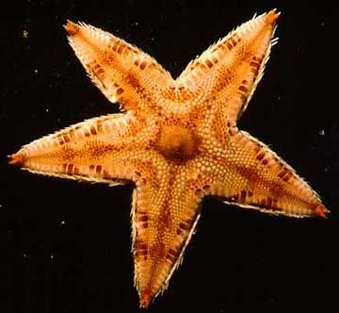
Echinodermata
By: Shayna Brown & Tiara Jackson

Slide 2
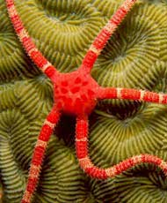
Taxon: Echinodermata
Echinodermata
Animal; Phylum
Which includes 21 Classes of Echinoderms such as starfish and many others

Slide 3
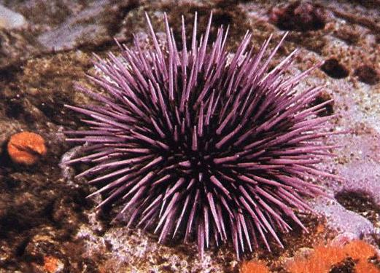
Symmetry
Echinoderms have Bilateral Symmetry when they are free swimming larvae, but then show Radial Symmetry at the time of metamorphosis.

Slide 4
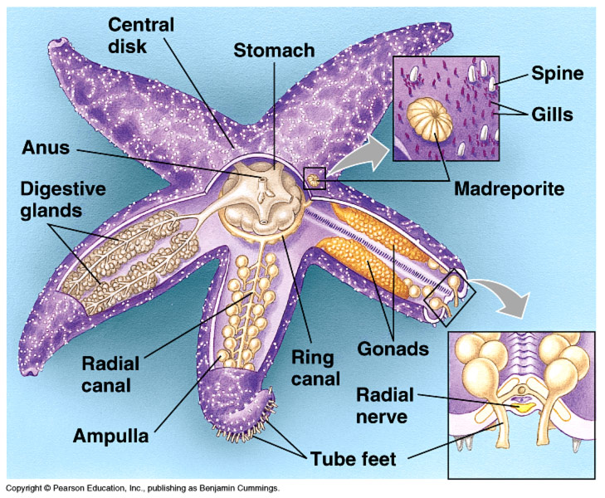
Body Cavity
In Echinoderms,
there is a presence
of a body cavity
except in ophiuroids

Slide 5
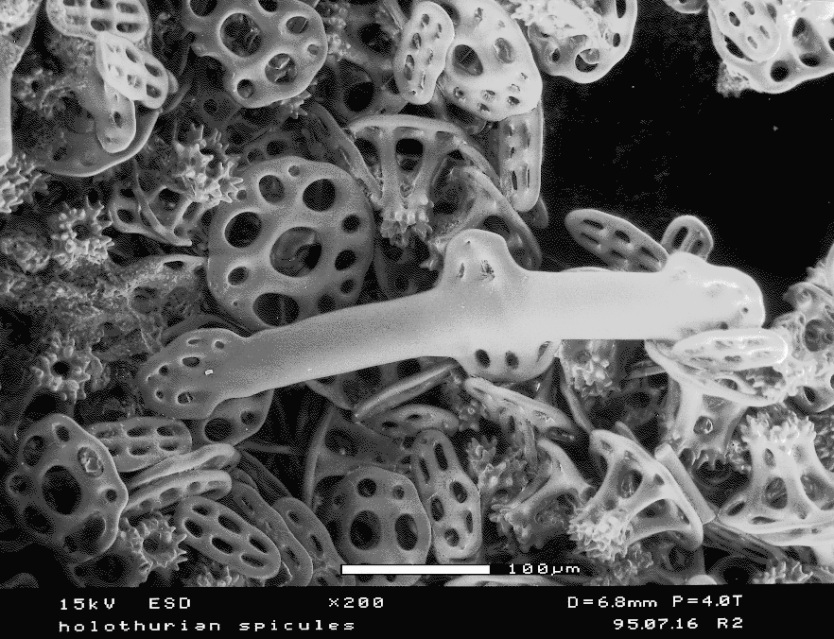
Tissue
Echinoderms
are trioblastic;
meaning three
layers which
include the
endo-, meso-,
and ectoderm.
Fig. 1 Photograph of tissue in a holothurian

Slide 6
Cephalization
Echinoderms display cephalization .
Cephalization is the process in animals by which nervous and sensory tissues become concentrated in the head
During their time when they have bilateral symmetry but when they lose bilateral symmetry to turn to radial symmetry, they lose cephalization.
Cephalization is associated primarily with bilaterally symmetrical species

Slide 7
Embryonic Development
Echinodermata are classified as deuterostomes
When echinodermata are in embryonic development , a ball of cells called a blastula develops an infolding called a blastopore, which eventually reaches the other side of the embryo and forms the digestive tract.
If the blastopore forms a mouth, the embryo is a called a protostome, meaning that the mouth (stoma) forms first (proto) after the anus. If the blastopore forms an anus, it is called a deuterostome, meaning that the mouth (stoma) forms second (deutero) after the anus. Since echinoderms are deuterostomes that means that the blastopore formed the anus.

Slide 8
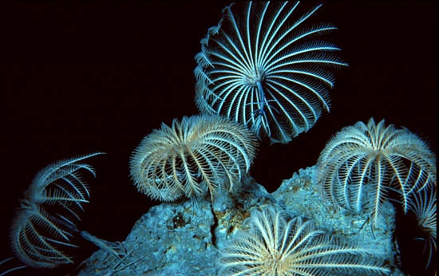
Digestive System
An Echinoderm has a mouth and stomach area. Some have a mouth on the bottom and an anus on the top. Starfish can actually turn their stomachs outside of their body and insert it into its prey's such as a clam. Echinoderms have a relatively big gut area.

Slide 9
Nervous System
Echinoderms have eyespots which can detect light.
Their eyespots are not as sharp as human eyes.
Echinoderms have a simple radial nervous system that consists of a modified nerve net (interconnected neurons with no central organs) and nerve rings, with radiating nerves around the mouth extending into each arm. The branches of these nerves coordinate the movements of the animal.

Slide 10
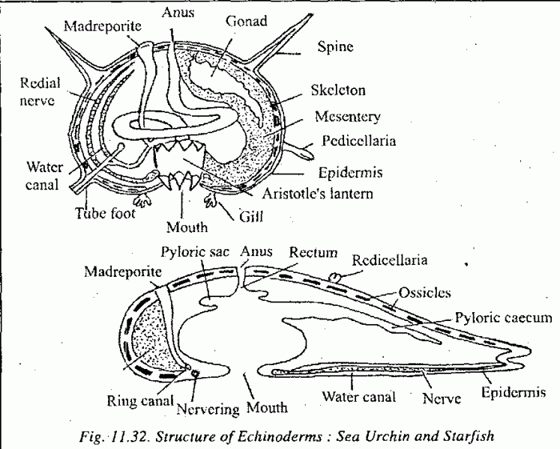
Nervous System of Star Fish

Slide 11
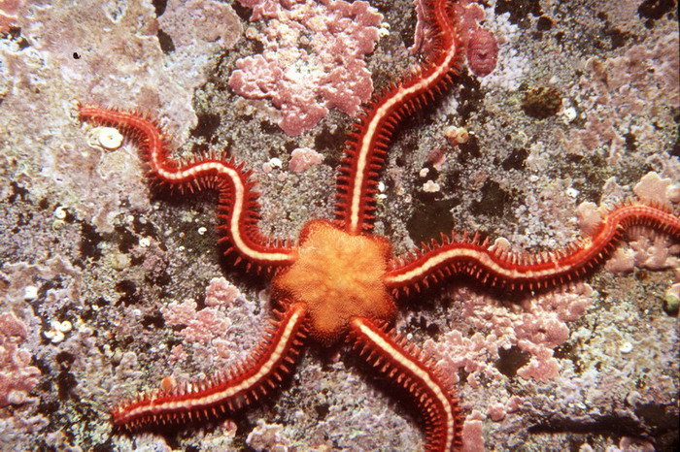
Excretory System
Echinoderms possess an open and reduced circulatory system, and have a complete digestive tube (tubular gut). They lack an excretory system.

Slide 12
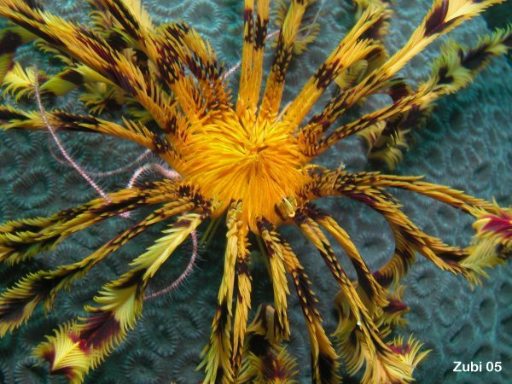
Circulatory System
Echinoderms have water pumped through its body as part of its very simple circulation system.

Slide 13
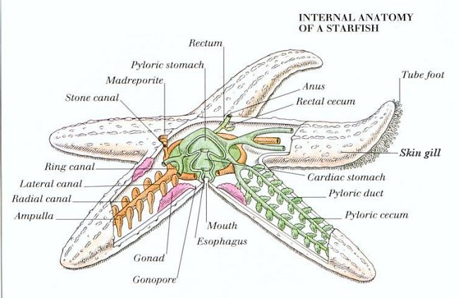
Internal Parts of the Star Fish

Slide 14
Major Events
There are two major events in the Echinoderms life cycle which are:
  Metamorphosis: After a few days to several weeks in a free-swimming form, echinoderm larvae undergo a complex transformation, or metamorphosis, that results in the juvenile echinoderm. During metamorphosis, the fundamental bilateral symmetry is overshadowed by a radial symmetry dominated by formation of five water-vascular canals
  Asexual Reproduction: Asexual reproduction in echinoderms usually involves the division of the body into two or more parts (fission) and the regeneration of missing body parts.

Slide 15
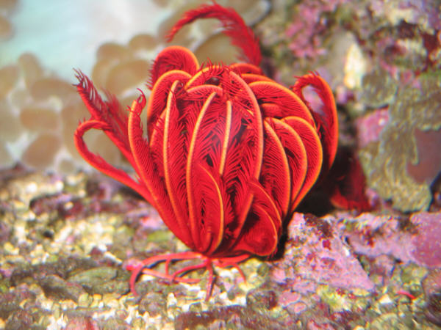
Examples of Echinoderms
Starfish
Sea star
Brittle star
Basket star
Holothurians
Sea cucumbers
Feather stars
Sea lilies
Fig 1. This is a feather star

Slide 16
Works Cited
A resource list with links where appropriate:
  http://userwww.sfsu.edu/~biol240/labs/lab_16animalbodyplan/pages/bodyplan.html
  http://www.britannica.com/EBchecked/topic/177910/echinoderm/25750/Body-wall-and-body-cavity
  http://bioweb.wku.edu/courses/biol225/225lab9.html
  http://www.novelguide.com/a/discover/ansc_02/ansc_02_00113.html
  http://www.novelguide.com/a/discover/ansc_01/ansc_01_00062.html
  http://www.newworldencyclopedia.org/entry/Echinoderm#Physiology
  http://www.starfish.ch/reef/echinoderms.html
Picture Sources
  http://www.starfish.ch/reef/echinoderms.html
  http://www.bu.edu/gk12/eric/brittle.jpg
  http://carolguze.com/images/animals/echinoderm.jpg
  http://www.pbs.org/kcet/shapeoflife/imganim/echinoderms1.jpg
  http://www.starfish.ch/Fotos/echinoderms-Stachelhauter/featherstars-Federsterne/Zygometra-sp-4.jpg
  http://www.itsnature.org/sea/other/common-brittle-star/

