Slide 1
Cnidarians
By:
Sibhat Hagos
Sam Palca

Slide 2
Intro to…how do you pronounce that?
Cnidarians (ni-dare-ians), phylum cnidaria, consists mainly of corals, jellies, and sea anemones
All have radial symmetry, are diploblastic, and none have actual cephalization (no head)
9,000 species discovered so far, and all live in an aquatic environment

Slide 3
The Naughty Bits
All species have gonads, which release gametes depending on the moon cycle, which produces mass spawnings and some cross-species hybrids
Fertilization occurs in the water, outside of the animal, and the larva swims until it finds a good place to implant and become a polyp which grows into an adult, although some species omit the polyp stage completely and skip straight to maturity
Because there is one orifice, they are neither protostomes or deuterostomes
All cnidaria can regenerate and reproduce asexually

Slide 4
Food, Glorious Food
Variety of feeding tactics; some hunt, others filter feed, and the rest (mostly corals) get nutrients from endosymbiotic algae within their cells
Food enters digestive cavity, and is set upon by enzymes which break it down into smaller pieces, which are in turn absorbed by the surrounding cells
Waste is excreted through the single orifice

Slide 5
I Can’t Breath!!!(or think)
No real respiration occurs, and most do simple exchanges of CO₂ and O₂ with their outer cells
Most are colonies of small organisms, and the circulatory system is also somewhat nonexistent
No brains or even central nervous systems, just nerve nets that mostly control and motor neurons, with very few species having underdeveloped “eyes” that can tell where light is coming from, and most can detect odors

Slide 6
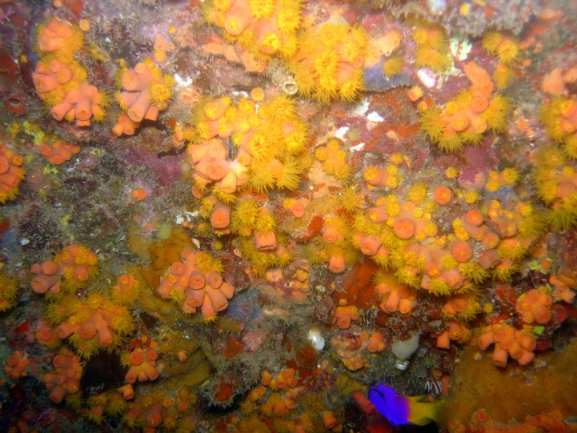
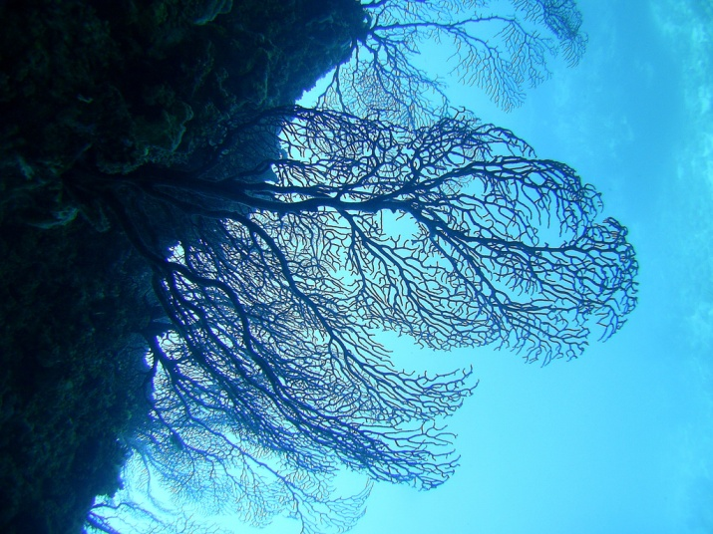
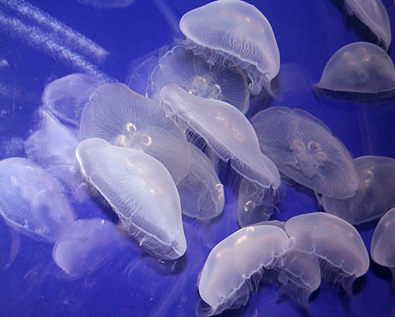
I Shall Call Him Squishy
Two classes, anthozoa (corals, anemones) and medusozoa (all the jellies)
Range from Man O’ Wars to sea nettles, from brain corals to fan corals

Slide 7
Works Cited
http://cas.bellarmine.edu/tietjen/images/cnidarians.htm
http://www.ucmp.berkeley.edu/cnidaria/cnidaria.html
http://blogs.nationalgeographic.com/blogs/intelligenttravel/2008/04/a-sting-more-painful-than-the.html

