Slide 1
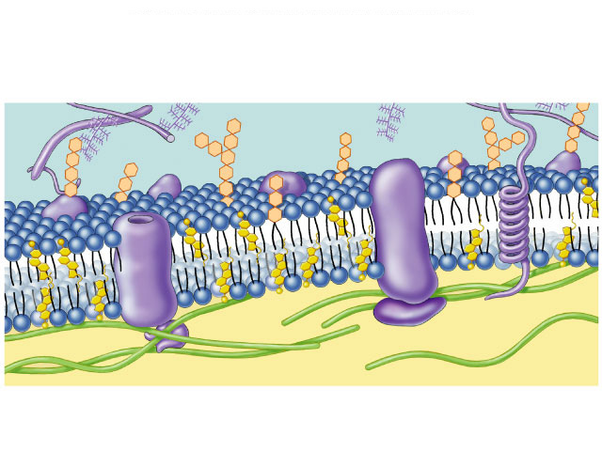
The Cell Membrane
(Ch. 7)

Slide 2
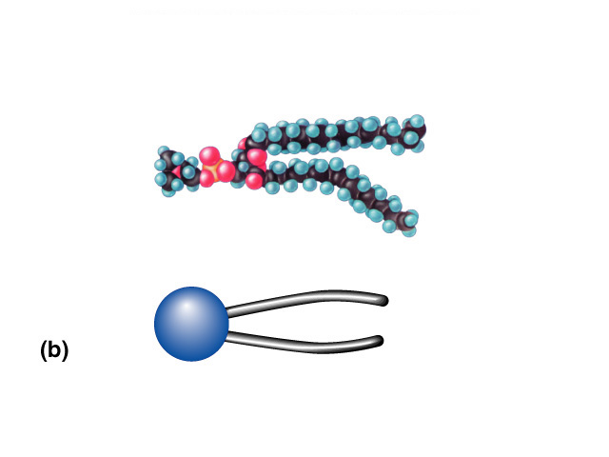
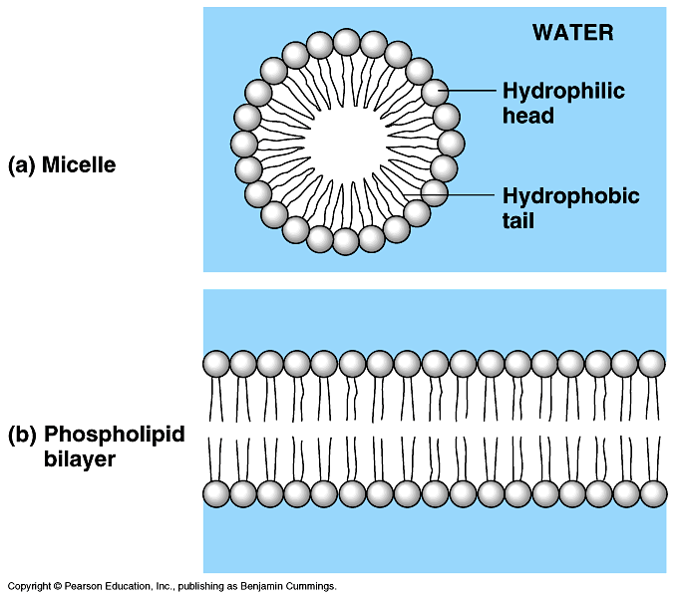

Phospholipids
Phosphate
Phosphate head
  hydrophilic
Fatty acid tails
  hydrophobic
Arranged as a bilayer
“attracted to water”
Fatty acid
“repelled by water”
Aaaah,
one of those
structure–function
examples

Slide 3
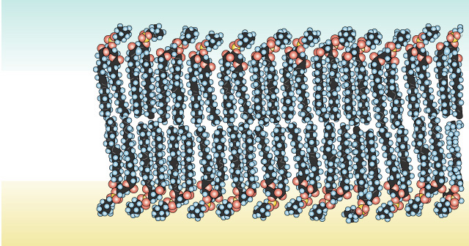
Arranged as a Phospholipid bilayer
Serves as a cellular barrier / border
sugar
H₂O
salt
polar
hydrophilic
heads
nonpolar
hydrophobic
tails
impermeable to polar molecules
polar
hydrophilic
heads
waste
lipids

Slide 4
Cell membrane defines cell
Cell membrane separates cell from aqueous environment
  Thin = 8nm thick
Controls transport in & out of the cell
  Some substances cross more easily than others
    hydrophobic (nonpolar) vs. hydrophilic (polar)
    Small vs. big.

Slide 5
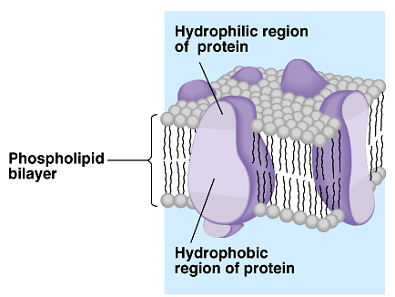
Cell membrane must be more than lipids…
In 1972, S.J. Singer & G. Nicolson proposed that membrane proteins are inserted into the phospholipid bilayer
It’s like a fluid…
It’s like a mosaic…
It’s the
Fluid Mosaic Model!

Slide 6
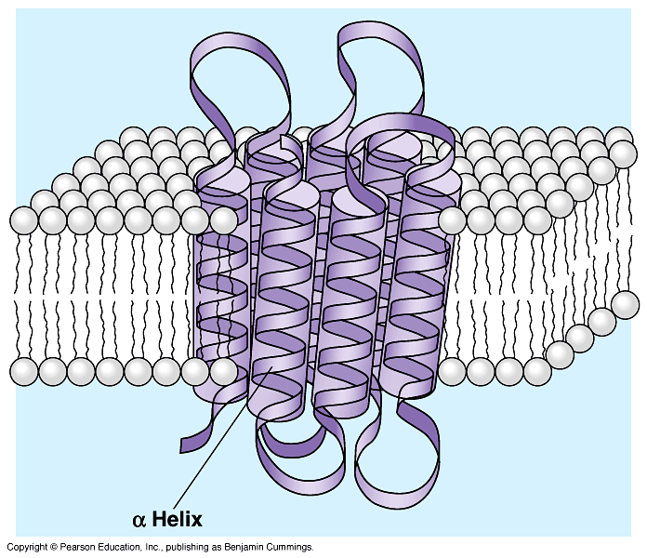
Permeability to polar molecules?
Membrane becomes semi-permeable via protein channels
  specific channels allow specific material across cell membrane
inside cell
H₂O
aa
sugar
salt
outside cell
NH₃

Slide 7
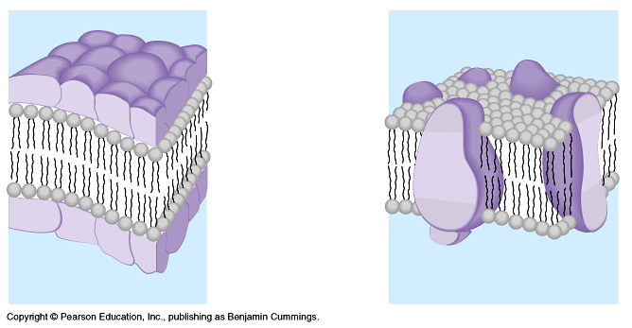
Cell membrane is more than lipids…
Transmembrane proteins embedded in phospholipid bilayer
  create semi-permeable channels
lipid bilayer
membrane
protein channels
in lipid bilyer membrane

Slide 8
Why are
proteins the perfect
molecule to build structures
in the cell membrane?

Slide 9
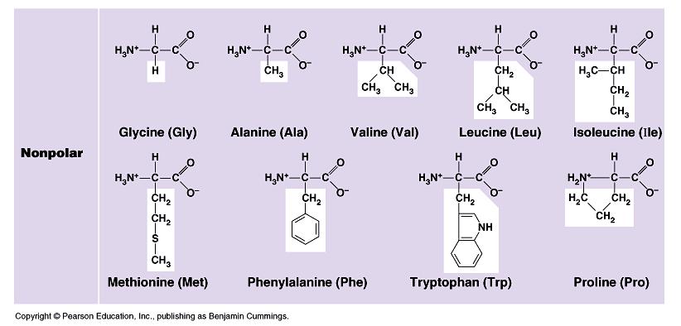
Classes of amino acids
What do these amino acids have in common?
nonpolar & hydrophobic

Slide 10
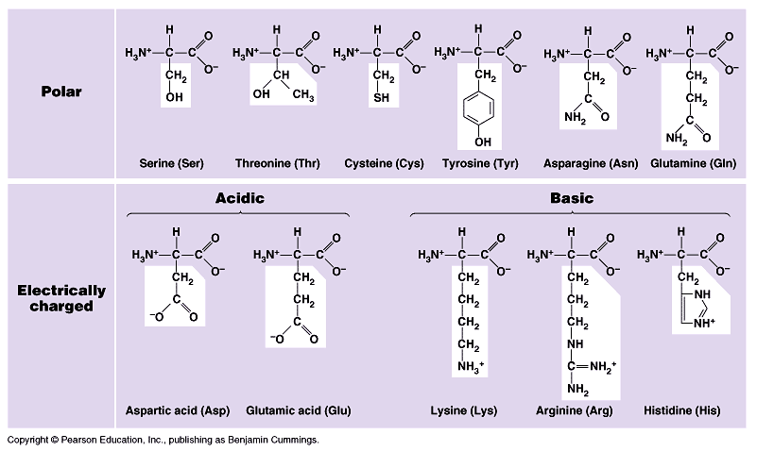
Classes of amino acids
What do these amino acids have in common?
I like the
polar ones
the best!
polar & hydrophilic

Slide 11
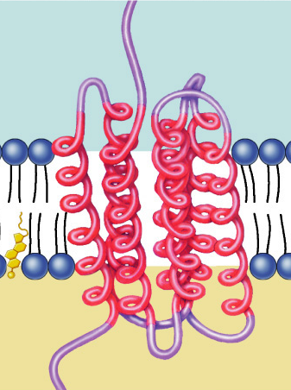
Protein domains anchor molecule
Within membrane
  nonpolar amino acids
    hydrophobic
    anchors protein
    into membrane
On outer surfaces of membrane in fluid
  polar amino acids
    hydrophilic
    extend into extracellular fluid & into cytosol
Polar areas
of protein
Nonpolar areas of protein

Slide 12
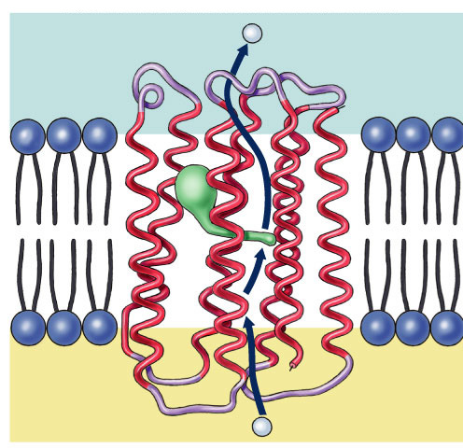
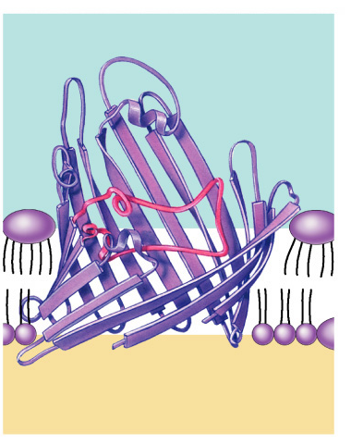
Examples
H⁺
H⁺
Retinal
chromophore
NH₂
aquaporin =
water channel in bacteria
H₂O
Porin monomer
β-pleated sheets
Bacterial
outer
membrane
Nonpolar
(hydrophobic)
α-helices in the
cell membrane
COOH
H⁺
Cytoplasm
H⁺
proton pump channel
in photosynthetic bacteria
function through conformational change =
protein changes shape
H₂O

Slide 13
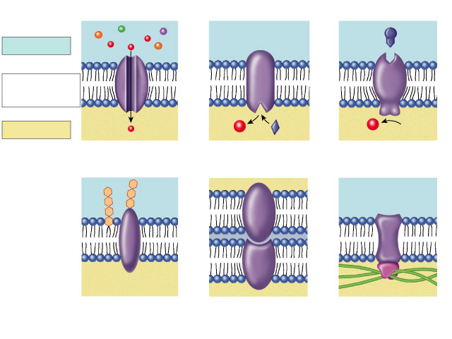
Many Functions of Membrane Proteins
Outside
Plasma
membrane
Inside
“Channel”
Transporter
Enzyme
activity
Cell surface
receptor
“Antigen”
Cell surface
identity marker
Cell adhesion
Attachment to the
cytoskeleton
Notes:
Signal transduction - transmitting a signal from outside the cell to the cell nucleus, like receiving a hormone which triggers a receptor on the inside of the cell that then signals to the nucleus that a protein must be made.

Slide 14
Membrane Proteins
Proteins determine membrane’s specific functions
  Every membrane in a cell has a unique collection of proteins
Classes of membrane proteins:
  peripheral proteins
    loosely bound to surface of membrane
    ex: cell surface identity marker (antigens)
  integral proteins
    penetrate lipid bilayer, across whole membrane
    “transmembrane” protein
    ex: transport proteins
      channels, permeases (pumps)

Slide 15
Membrane is a collage of proteins & other molecules embedded in the fluid matrix of the lipid bilayer
Glycoprotein
Extracellular fluid
Glycolipid
Phospholipids
Cholesterol
Transmembrane
proteins
Peripheral
protein
Cytoplasm
Filaments of
cytoskeleton
Notes:
The carbohydrates are not inserted into the membrane -- they are too hydrophilic for that. They are attached to embedded proteins -- glycoproteins.

Slide 16
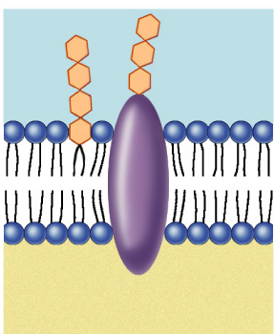
Membrane carbohydrates
Play a key role in cell-cell recognition
  ability of a cell to distinguish one cell from another
    antigens
  important in organ &
  tissue development
  basis for rejection of
  foreign cells by
  immune system
Notes:
The four human blood groups (A, B, AB, and O) differ in the external carbohydrates on red blood cells.

Slide 17
Any Questions??

Slide 18
Review Questions

Slide 19
Which of the following is not a component of cell membranes?
  Nucleotides
  Carbohydrates
  Proteins
  Cholesterol
  Phospholipids

Slide 20
2. The fluid mosaic model of the cell membrane states that
  Proteins are embedded in the phospholipid bi-layer.
  Hydrophobic regions of proteins are on the external surface of the membrane, exposed to water
  Membranes are composed only of lipids and phosphates
  The hydrophilic tails of phospholipids are adjacent to each other
  Proteins exist in the membrane sandwiched between phospholipid layers.

