Slide 1
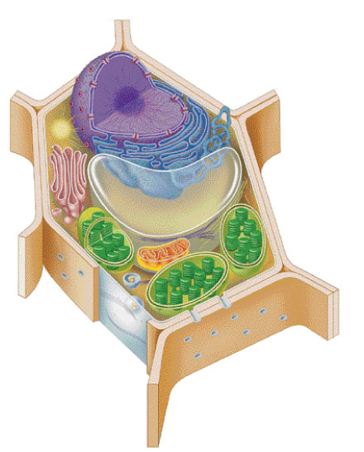
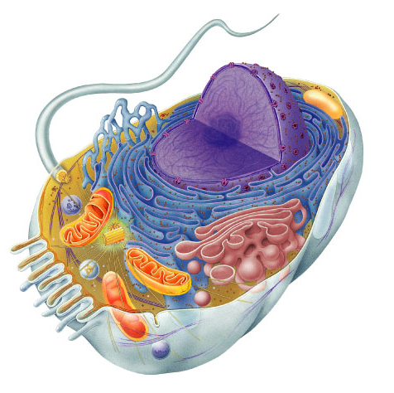
Tour of the Cell 3
(Ch. 6)

Slide 2
Cells gotta work to live!
What jobs do cells have to do?
  make proteins
    proteins control every
    cell function
  make energy
    for daily life
    for growth
  make more cells
    growth
    repair
    renewal

Slide 3
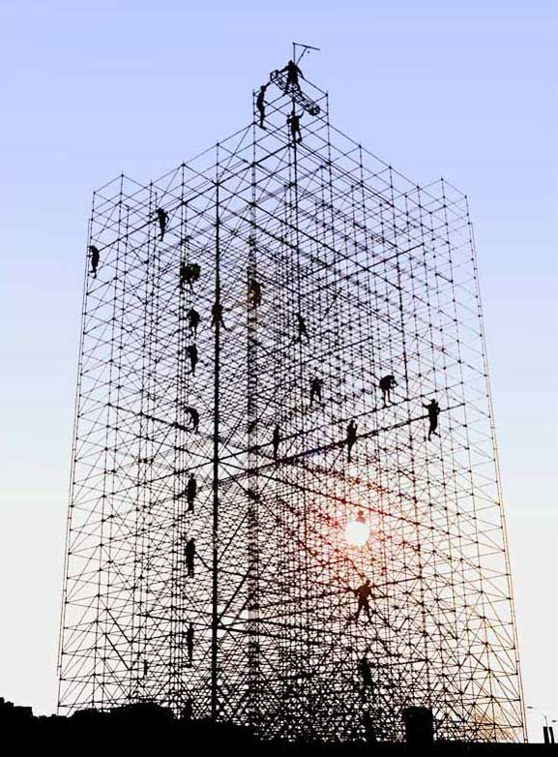
Making New Cells

Slide 4

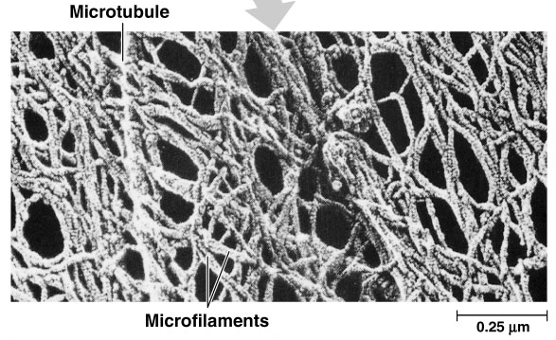
Cytoskeleton
Function
  structural support
    Maintains cell shape
    Anchorage for organelles
      protein fibers
        microfilaments, intermediate filaments, microtubules
  motility
    cell locomotion
    cilia, flagella, etc.
  regulation
    organizes structures
    & activities of cell

Slide 5
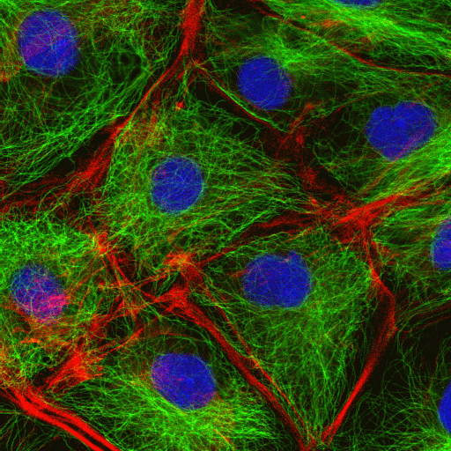

Cytoskeleton
actin
microtubule
nuclei

Slide 6
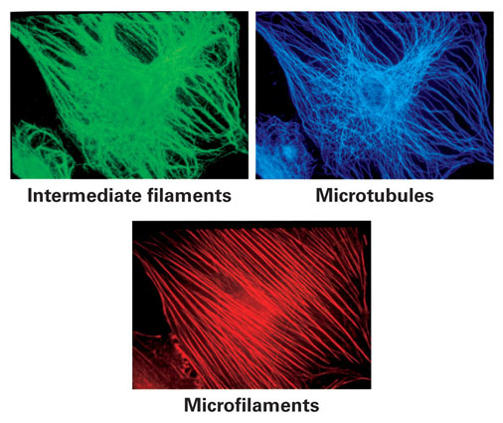

Slide 7
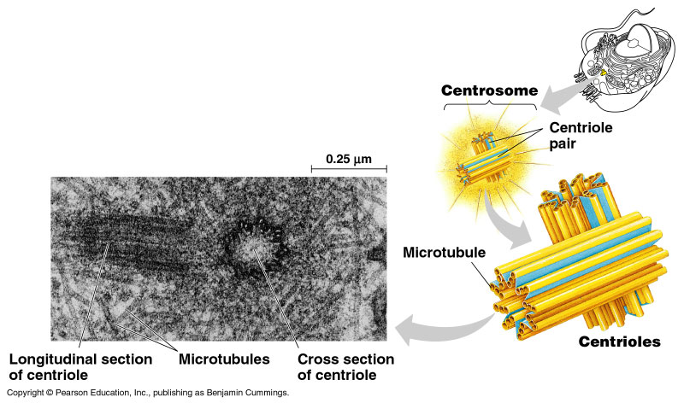
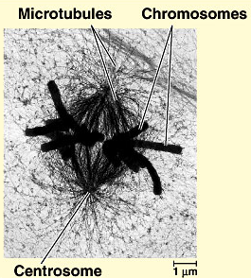
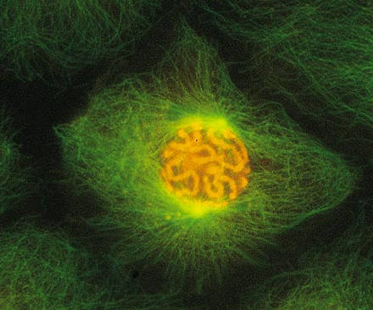
Centrioles
Cell division
  in animal cells, pair of centrioles
  organize microtubules
    spindle fibers
  guide chromosomes in mitosis

Slide 8
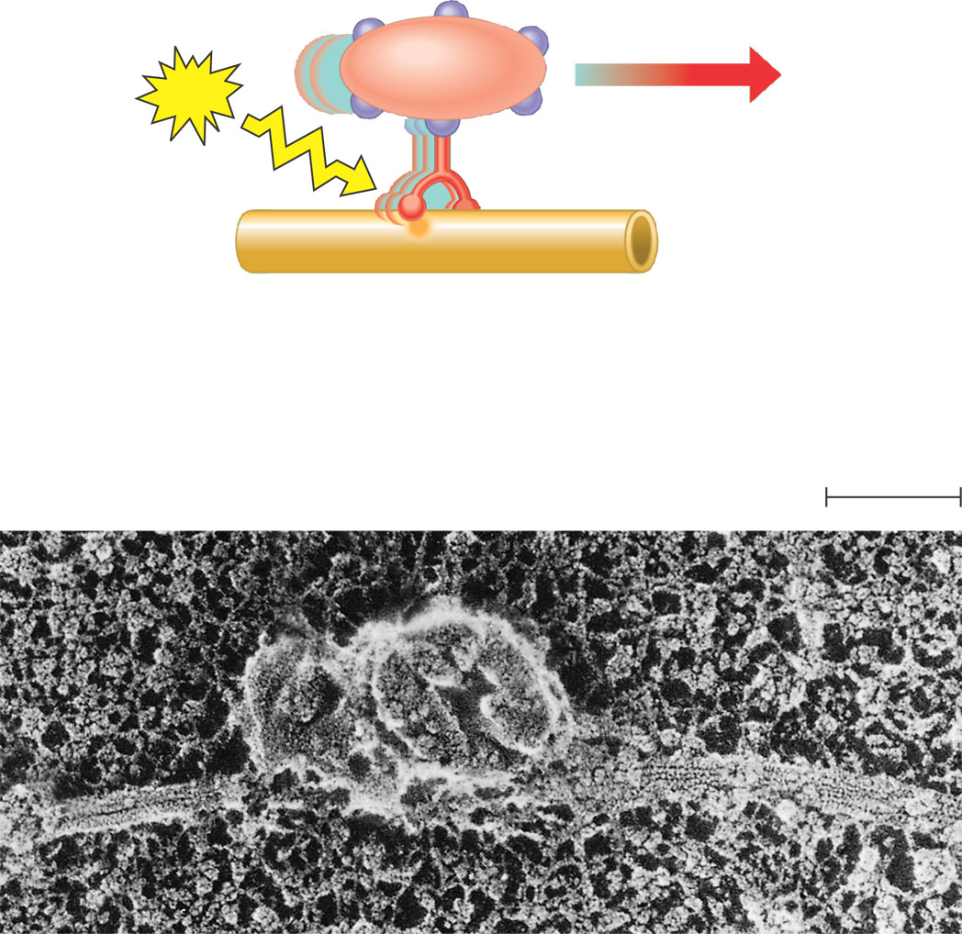
Motor proteins and the cytoskeleton
ATP
Vesicle
Receptor for
motor protein
Motor protein
(ATP powered)
Microtubule
of cytoskeleton
(a) Motor proteins that attach to receptors on organelles can “walk”
the organelles along microtubules or, in some cases, microfilaments.
Microtubule
Vesicles
0.25 µm
(b) Vesicles containing neurotransmitters migrate to the tips of nerve cell
axons via the mechanism in (a). In this SEM of a squid giant axon, two
vesicles can be seen moving along a microtubule. (A separate part of the
experiment provided the evidence that they were in fact moving.)

Slide 9
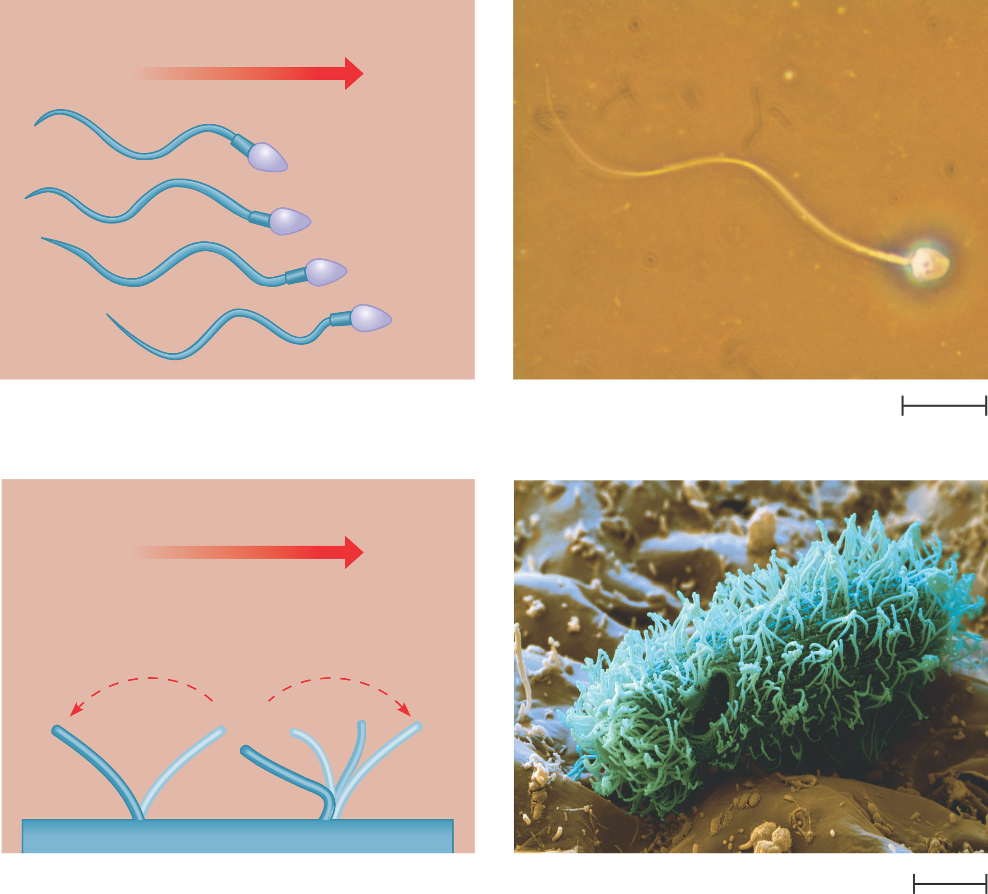
Cillia and Flagella
(a) Motion of flagella. A flagellum
usually undulates, its snakelike
motion driving a cell in the same
direction as the axis of the
flagellum. Propulsion of a human
sperm cell is an example of
flagellate locomotion (LM).
Direction of swimming
1 µm
(b) Motion of cilia. Cilia have a back-
and-forth motion that moves the
cell in a direction perpendicular
to the axis of the cilium. A dense
nap of cilia, beating at a rate of
about 40 to 60 strokes a second,
covers this colpidium, a
freshwater protozoan (SEM).
Direction of organism’s movement
Direction of
active stroke
Direction of
recovery stroke
15 µm

Slide 10
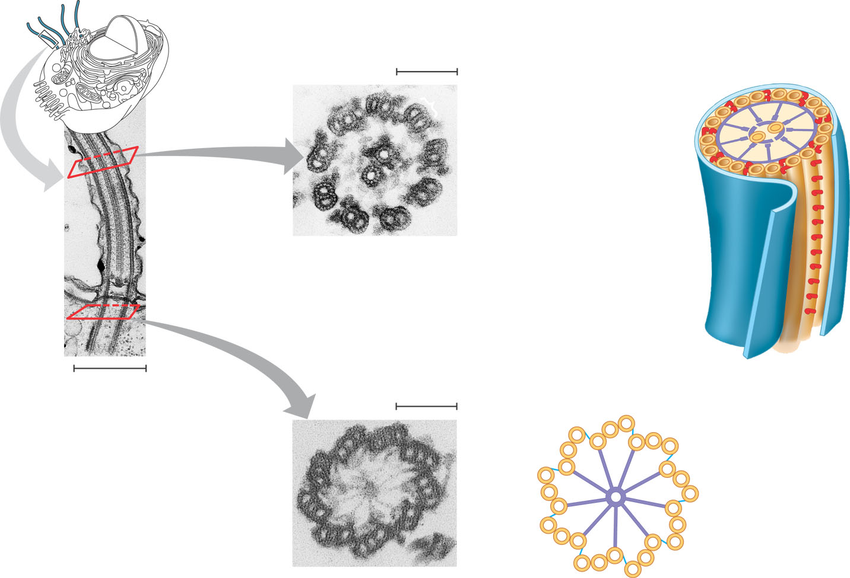
Ultrastructure of a eukaryotic flagellum or cilium
Outer microtubule
doublet
Plasma
membrane
0.1 µm
Dynein arms
Central
microtubule
Outer doublet
cross-linking
proteins
Microtubules
Radial
spoke
Plasma
membrane
(b) A cross section through the cilium shows the ”9 + 2“
arrangement of microtubules (TEM). The outer micro-
tubule doublets and the two central microtubules are
held together by cross-linking proteins (purple in art),
including the radial spokes. The doublets also have
attached motor proteins, the dynein arms (red in art).
Basal body
0.5 µm
(a) A longitudinal section of a cilium shows micro-
tubules running the length of the structure (TEM).
0.1 µm
Triplet
(c) Basal body: The nine outer doublets of a
cilium or flagellum extend into the basal body,
where each doublet joins another microtubule
to form a ring of nine triplets. Each triplet is
connected to the next by non-tubulin proteins
(blue). The two central microtubules terminate
above the basal body (TEM).
Cross section of basal body

Slide 11
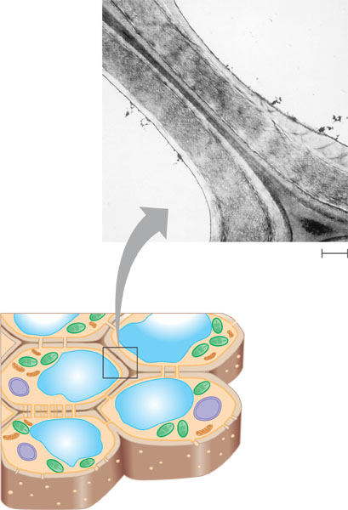
Plant cell walls
Central
vacuole
of cell
Plasma
membrane
Secondary
cell wall
Primary
cell wall
Central
vacuole
of cell
Middle
lamella
1 µm
Central vacuole
Cytosol
Plasma membrane
Plant cell walls
Plasmodesmata

Slide 12
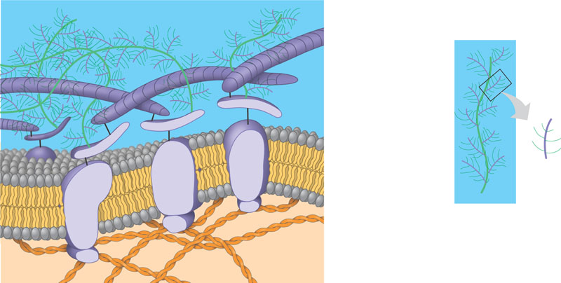
Extracellular matrix (ECM) of an animal cell
Collagen fibers
are embedded
in a web of
proteoglycan
complexes.
A proteoglycan
complex consists
of hundreds of
proteoglycan
molecules attached
noncovalently to a
single long polysac-
charide molecule.
Polysaccharide
molecule
EXTRACELLULAR FLUID
Carbo-
hydrates
Fibronectin
attaches the
ECM to
integrins
embedded in
the plasma
membrane.
Core
protein
Integrins are membrane
proteins that are bound
to the ECM on one side
and to associated
proteins attached to
microfilaments on the
other. This linkage can
transmit stimuli
between the cell’s
external environment
and its interior and can
result in changes in cell
behavior.
Proteoglycan
molecule
Plasma
membrane
Integrin
Micro-
filaments
CYTOPLASM

Slide 13
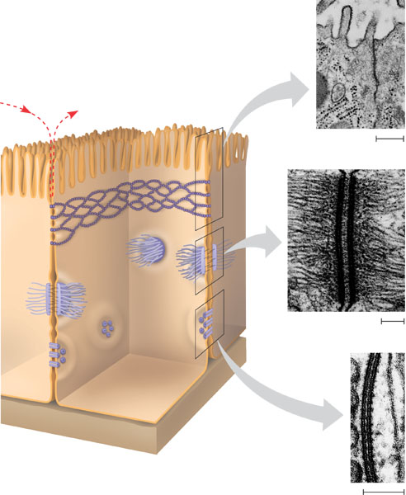
Intercellular Junctions in Animal Tissues
TIGHT JUNCTIONS
At tight junctions, the membranes of
neighboring cells are very tightly pressed
against each other, bound together by
specific proteins (purple). Forming continu-
ous seals around the cells, tight junctions
prevent leakage of extracellular fluid across
a layer of epithelial cells.
Tight junctions prevent
fluid from moving
across a layer of cells
Tight junction
0.5 µm
DESMOSOMES
Desmosomes (also called anchoring
junctions) function like rivets, fastening cells
together into strong sheets. Intermediate
filaments made of sturdy keratin proteins
anchor desmosomes in the cytoplasm.
Tight junctions
Intermediate
filaments
Desmosome
Gap
junctions
1 µm
GAP JUNCTIONS
Gap junctions (also called communicating
junctions) provide cytoplasmic channels from
one cell to an adjacent cell. Gap junctions
consist of special membrane proteins that
surround a pore through which ions, sugars,
amino acids, and other small molecules may
pass. Gap junctions are necessary for commu-
nication between cells in many types of tissues,
including heart muscle and animal embryos.
Extracellular
matrix
Space
between
cells
Plasma membranes
of adjacent cells
Gap junction
0.1 µm

Slide 14
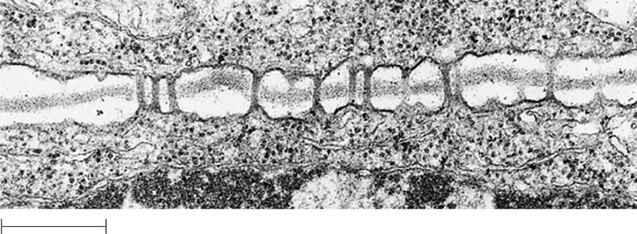
Plasmodesmata between plant cells
Cell walls
Interior
of cell
Interior
of cell
0.5 µm
Plasmodesmata
Plasma membranes

Slide 15
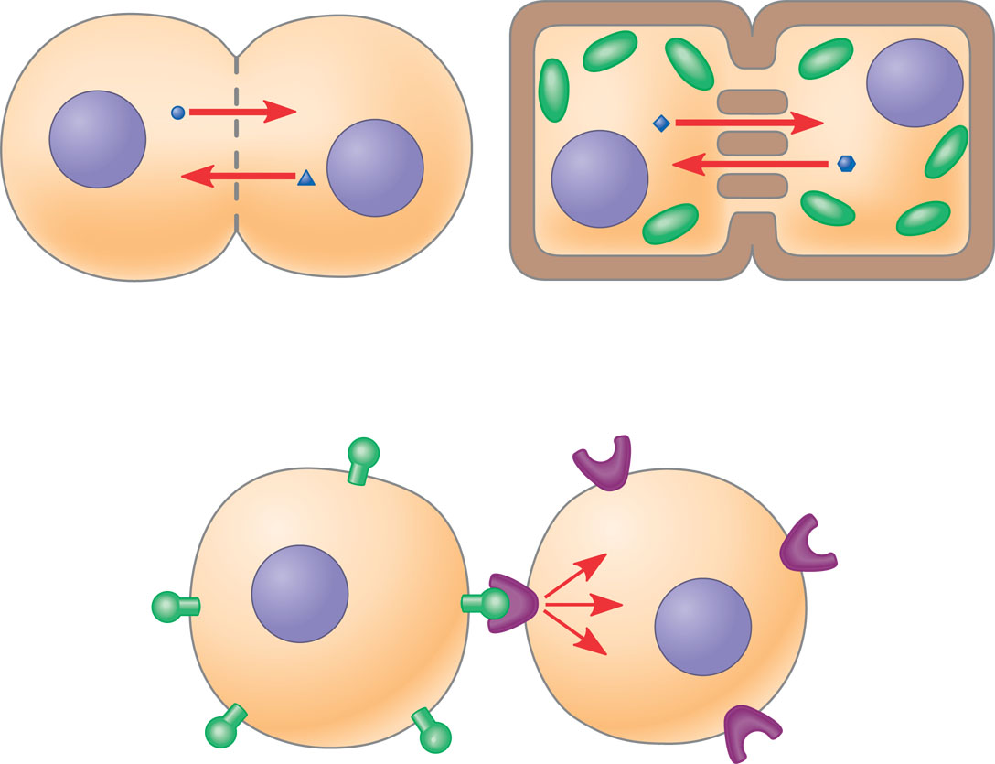
Communication by direct contact between cells
Plasma membranes
Gap junctions
between animal cells
Plasmodesmata
between plant cells
(a) Cell junctions. Both animals and plants have cell junctions that allow molecules
to pass readily between adjacent cells without crossing plasma membranes.
(b) Cell-cell recognition. Two cells in an animal may communicate by interaction
between molecules protruding from their surfaces.

Slide 16
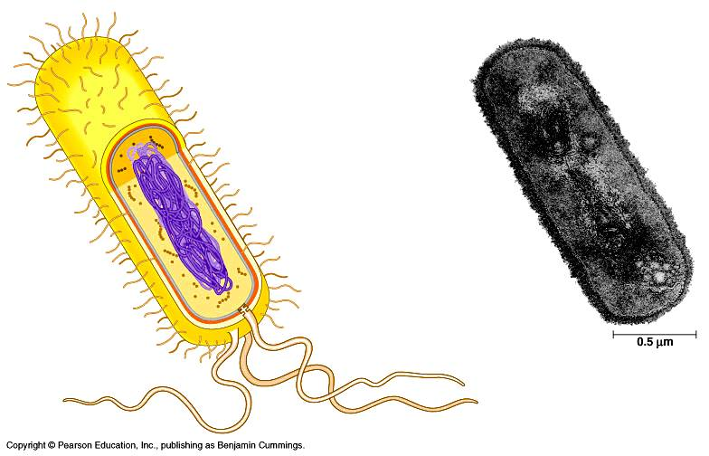
Any Questions!!

Slide 17
Review Questions
0

Slide 18
0
1.. In which cell would you expect to find the most tight junctions?
  Muscle cell in the thigh muscle of a long-distance runner
  Pancreatic cell that manufactures digestive enzymes
  Macrophage (white blood cell) that engulfs bacteria
  Epithelial cells lining the digestive tract
  Ovarian cell that produces estrogen (a steroid hormone)
Notes:
Answer: d
Source: Taylor - Student Study Guide for Biology, Sixth Edition, Test Your Knowledge Question #16

Slide 19
0
2. Which of the following cytoskeletal elements forms the centrioles within a cell?
  Collagen
  Microfillaments
  Microtubules
  Pseudopodia
  Intermediate Fillaments
Notes:
Answer: d
Source: Taylor - Student Study Guide for Biology, Sixth Edition, Test Your Knowledge Question #16

Slide 20
0
In human cells, the cell wall is
  Composed of polysaccharides
  Composed of peptidoglycan
  Responsible for limiting the absorption of water
  Involved in controlling mitosis
  Not present.
Notes:
Answer: d
Source: Taylor - Student Study Guide for Biology, Sixth Edition, Test Your Knowledge Question #16

Slide 21

Now let’s look at something
old...with new eyes!

